Slide 1

Final Chat App
Team Tofu – December 2nd, 2019 Xiongfeng Song, Hao Lin, Neil Chen Siyang Zhang, Zhaokang Pan, Ian Fan
Notes:
(Xiongfeng)

Slide 2

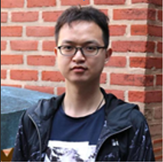


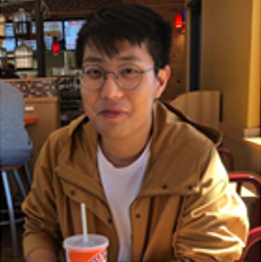

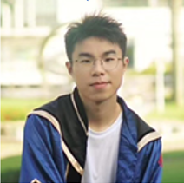
Team Lead Xiongfeng
Tech Lead Hao
Doc Lead Neil
Front-End Dev Siyang
Back-End Dev Zhaokang
Back-End Dev Ian
Notes:
(Xiongfeng)

Slide 3
Content
UML diagram and Data Flow
Model: Data classes
Message, ChatRoom, User, DataStorage
Model: Tools
GetListWrapper, RequestPayload, PayloadParser, Status
Model: Logic classes
DispatchAdapter, Commands, ResponseAdapter
Controller and View
Functionality demo
Notes:
(Xiongfeng)

Slide 4
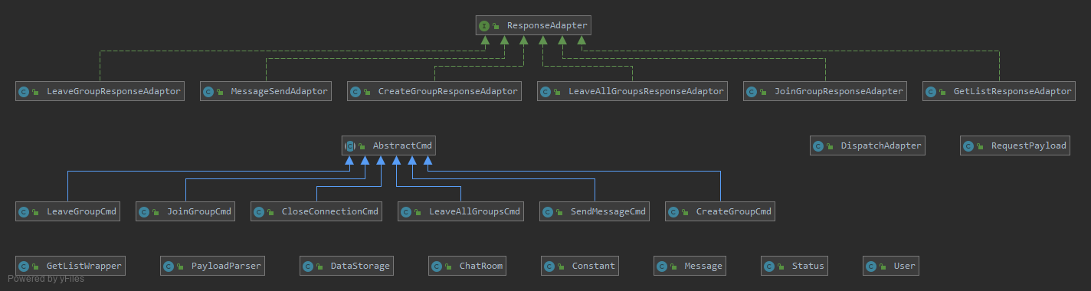
Complete UML Diagram
Notes:
(Xiongfeng)

Slide 5
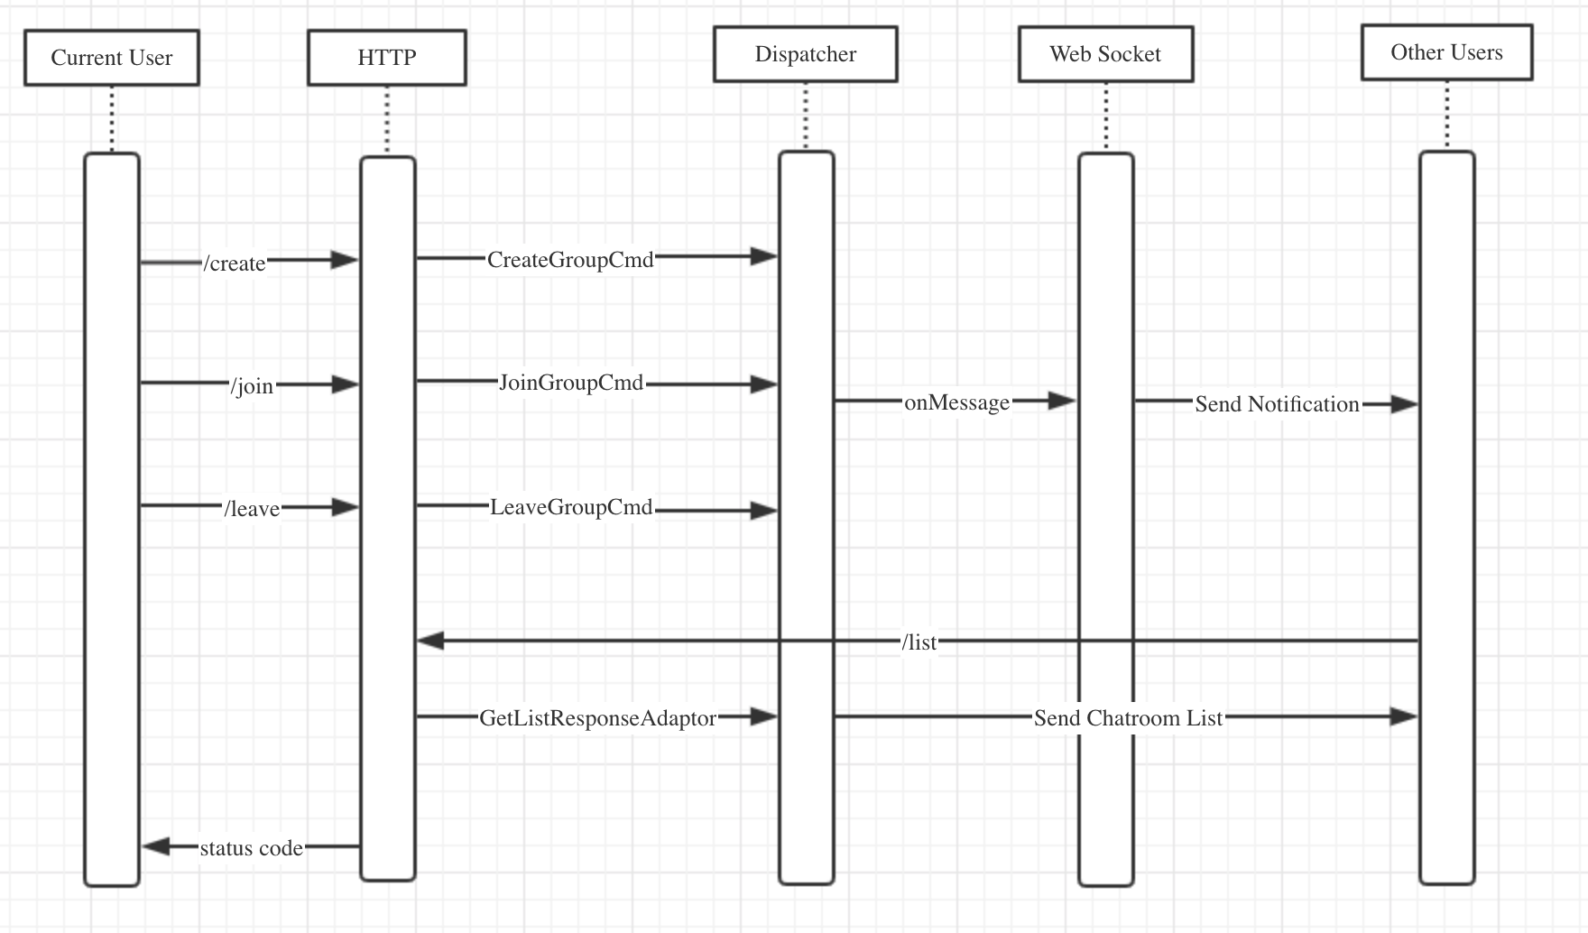
Data Flow
Notes:
(Xiongfeng)

Slide 6
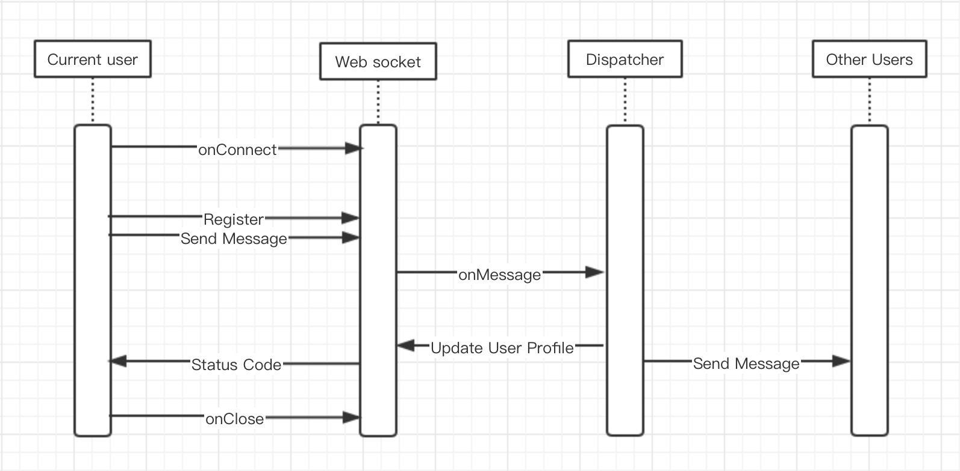
Data Flow
Notes:
(Xiongfeng)
Introduce Hao Lin to talk about data storage classes

Slide 7
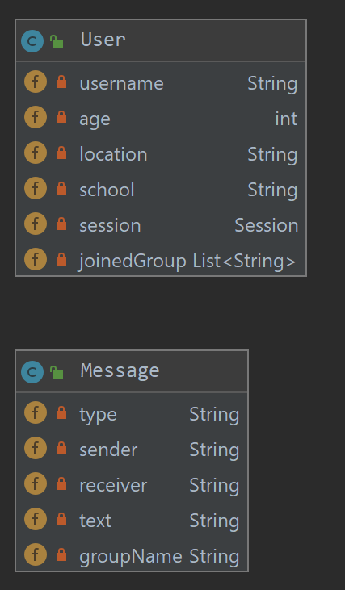
Model: User and Message
User
Username Session
Profile information
List of joined ChatRoom names
Implements PCL to execute cmd Message
Type
Sender and receiver
Message text
ChatRoom name
Notes:
(Hao Lin)

Slide 8
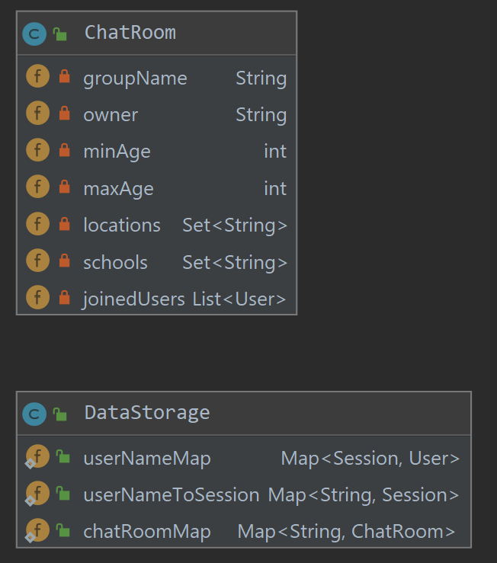
Model: ChatRoom and DataStorage
ChatRoom
Name
Owner
Profile restrictions
List of joined Users
DataStorage
Maps between different User and ChatRoom data
Notes:
(Hao Lin)
Introduce Ian to talk about the utility classes

Slide 9
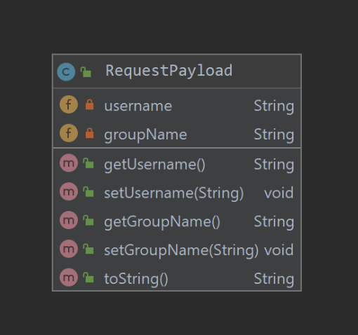
Model: Tools
Request Payload
Prepares a String representation of username and groupName
PayloadParser
Example: createUser
Generates a User from JSON payload information
Notes:
(Ian)

Slide 10
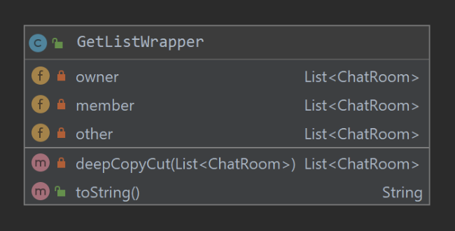
Model: Tools
GetListWrapper
Prepares a String representation of the ChatRoom lists
Status
Used to represent HTTP status codes
200, 403, 409, etc
Notes:
(Ian)

Slide 11
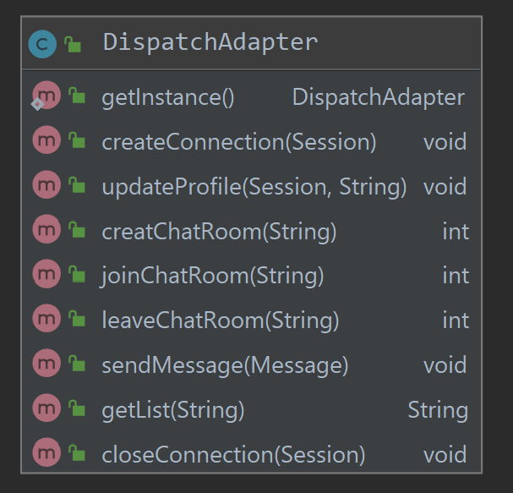
Model: DispatchAdapter
Singleton
Communicates with Controller and View
Creates/closes connections
Updates User profiles
Create/join/leave ChatRoom
Sends messages
Get lists of ChatRooms for a User
Notes:
(Zhaokang)

Slide 12
Model: ResponseAdapter
Interface to retrieve JSON representations to respond to clients
Response adapters for:
Creating ChatRooms
Get list of ChatRooms for a User
Join ChatRoom
Leave all ChatRooms
Message send
Simple example: MessageSendAdapter
Initialized with a Message
getJsonRepresentation will return a String Json representation
public class MessageSendAdaptor implements ResponseAdapter { private Message message; public MessageSendAdaptor(Message message) { this.message = message; } @Override public String getJsonRepresentation(Gson gson) { return gson.toJson(message); } }
Notes:
(Zhaokang)

Slide 13
Model: AbstractCmd
Abstract class to enable command design pattern
Commands for:
Closing connections
Creating ChatRooms
Joining ChatRooms
Leaving ChatRoom / all ChatRooms
Send Message
Simple example: SendMessageCmd
Initialized with a message
Calls the appropriate chatroom method
public class SendMessageCmd extends AbstractCmd { private Message message; public SendMessageCmd(Message message) { this.message = message; } @Override public void execute(User user) { ChatRoom chatRoom = chatRoomMap.get(message.getGroupName()); chatRoom.notifyUser(message, user); } }
Notes:
(Zhaokang) Introduce Siyang to talk about Controller and View

Slide 14
Controllers
ChatAppController
static int getHerokuAssignedPort()
Allows for hosting on Heroku
Endpoints
/create
/join
/leave
/list
WebSocketController
onConnect()
onClose()
onMessage()
Notes:
(Siyang)

Slide 15
View
Front-end is rendered according to the data stored in DispatchAdapter, and different messages received from WebSocket will trigger different front-end behaviors
View functionality:
For a new session: set profile information
Display joined and joinable rooms
Show users in a selected room
Show session message history with a selected user
Options to create/join/leave rooms
Notes:
(Siyang) Introduce Neil to give demo

Slide 16
Conclusion: Chat App Functionality Demo
https://chatapp-team-tofu.herokuapp.com/ Questions?
Notes:
(Neil)

